Slide 1
Journey Scrapbook
Akshat Gupta
Batch-6

Slide 2
Custom Training Week - 2
04-Sept-2023 to 08-Sept-2023

Slide 3
Day 1
Azure Storage account
Regions – LRS, GRS, ZRS, GZRS
Access tiers – Hot and Cold
Creating Azure Storage Account
Creating fileshare
Using snapshots

Slide 4
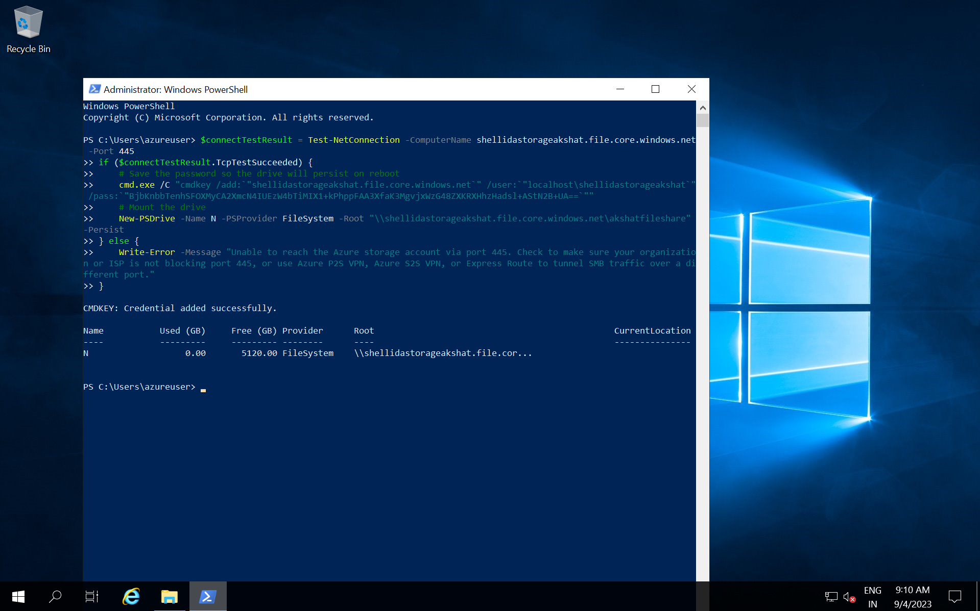

Slide 5
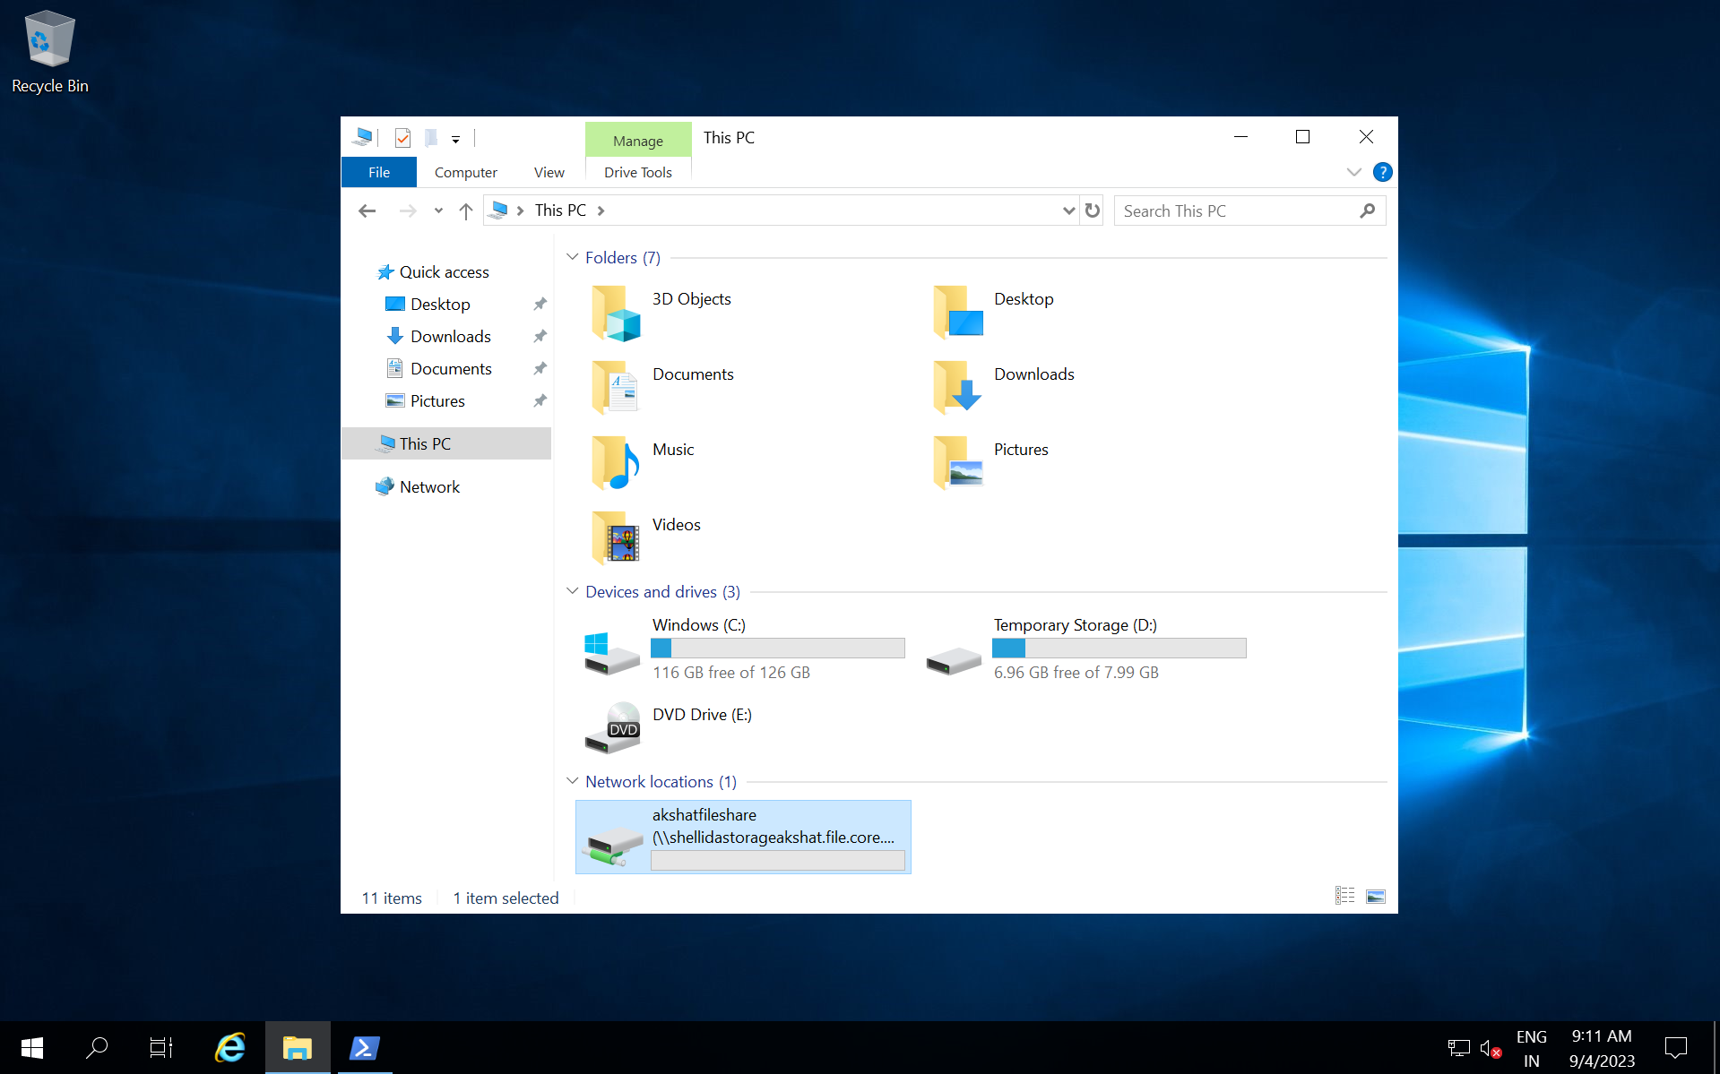

Slide 6
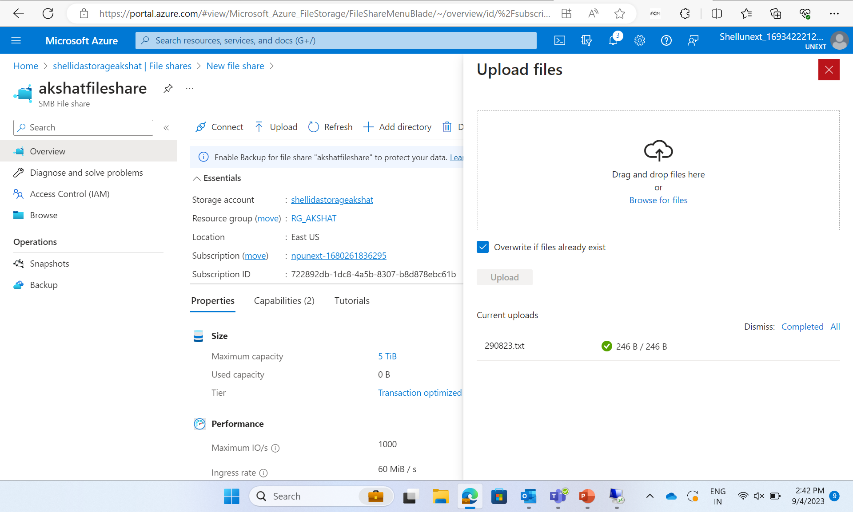

Slide 7
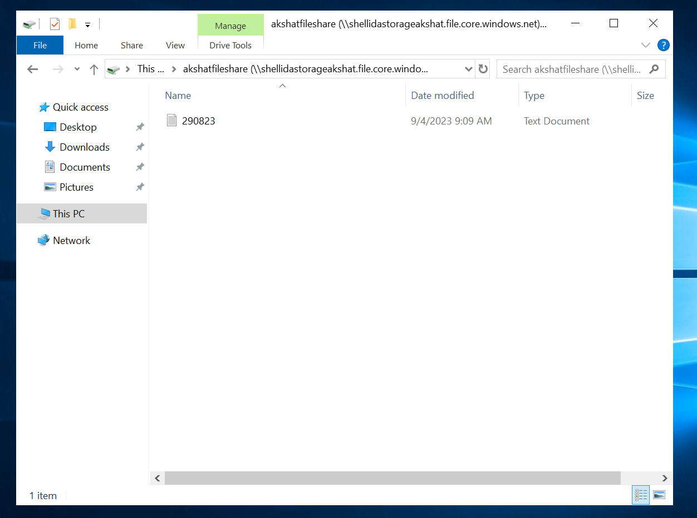

Slide 8
Day 2
Access keys – SAS(Shared Access Signature) is time bounded access
Introduction to Azure Data Factory
ADF Components
Configuring ADF for Copying data
Scheduling a pipeline
Transforming Data
Copying Data from Different Sources

Slide 9
ETL – Transform done by Azure Data Bricks
E and L done by Azure Data Factory
ADF Components –
Pipelines
Activities
Datasets
Linked services
Integration runtime
Triggers
Data flow
Creating data pipelines

Slide 10
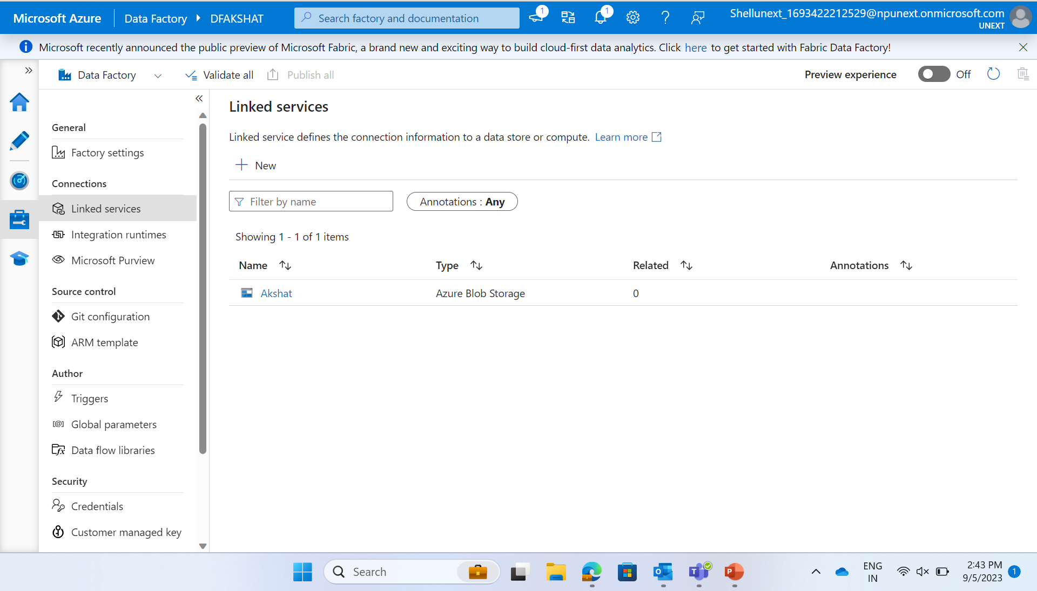

Slide 11
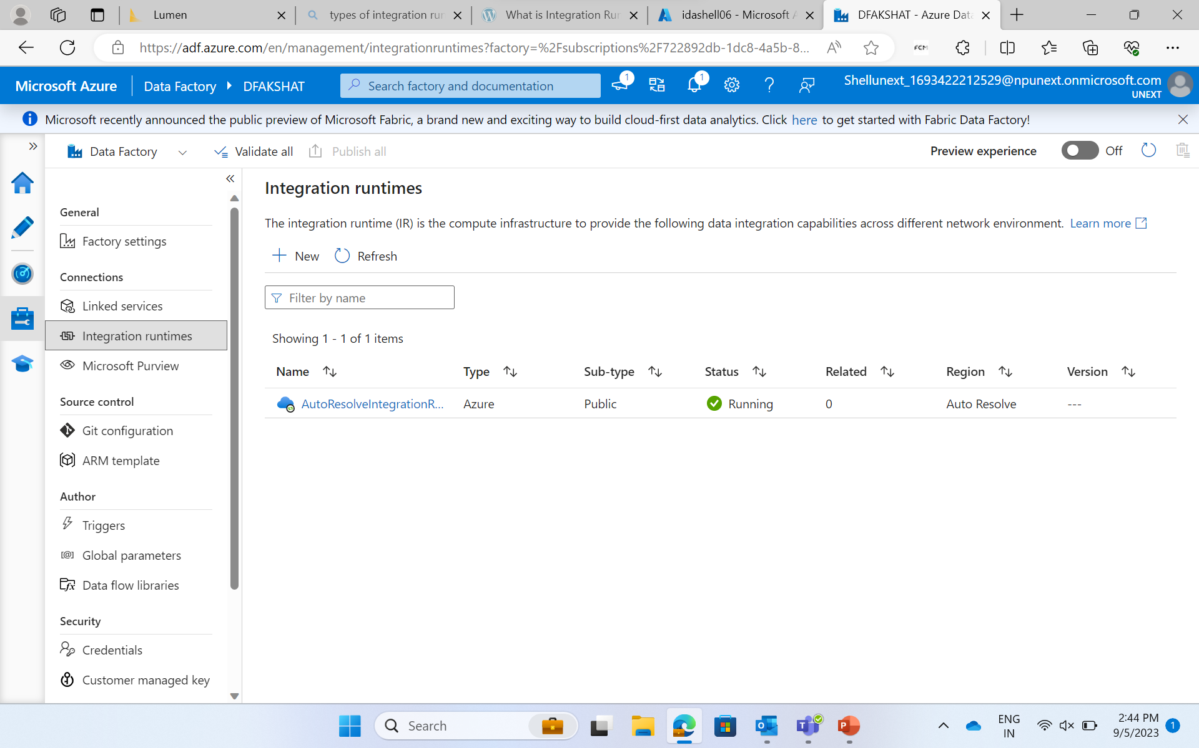

Slide 12
Day 3
Create data factory
Activities in pipeline – String, Boolean, Array and Integer Activities in pipelines
Execute pipeline activity
SSIS Package (Azure SSIS IR)
Get metadata activity
Parameter concept implementation
Triggers
If-else condition for get metadata in pipelines, for each loop

Slide 13
Day 4
Parsing of the JSON file
Data flows
Dataflow expression builder and derived columns
Surrogate key
For each container and get metadata
API

Slide 14
Day 5
Creating SQL Database on VM
Lookup table in SQL database
Lookup table with for each pipeline
Change Data Capture (CDC) – used to save time and resources
It is there in all database systems
Analyze the mismatch between records and insert/delete it in the updated table
*Insert, Update, Delete*
Automation accounts – Runbook or automation

Slide 15
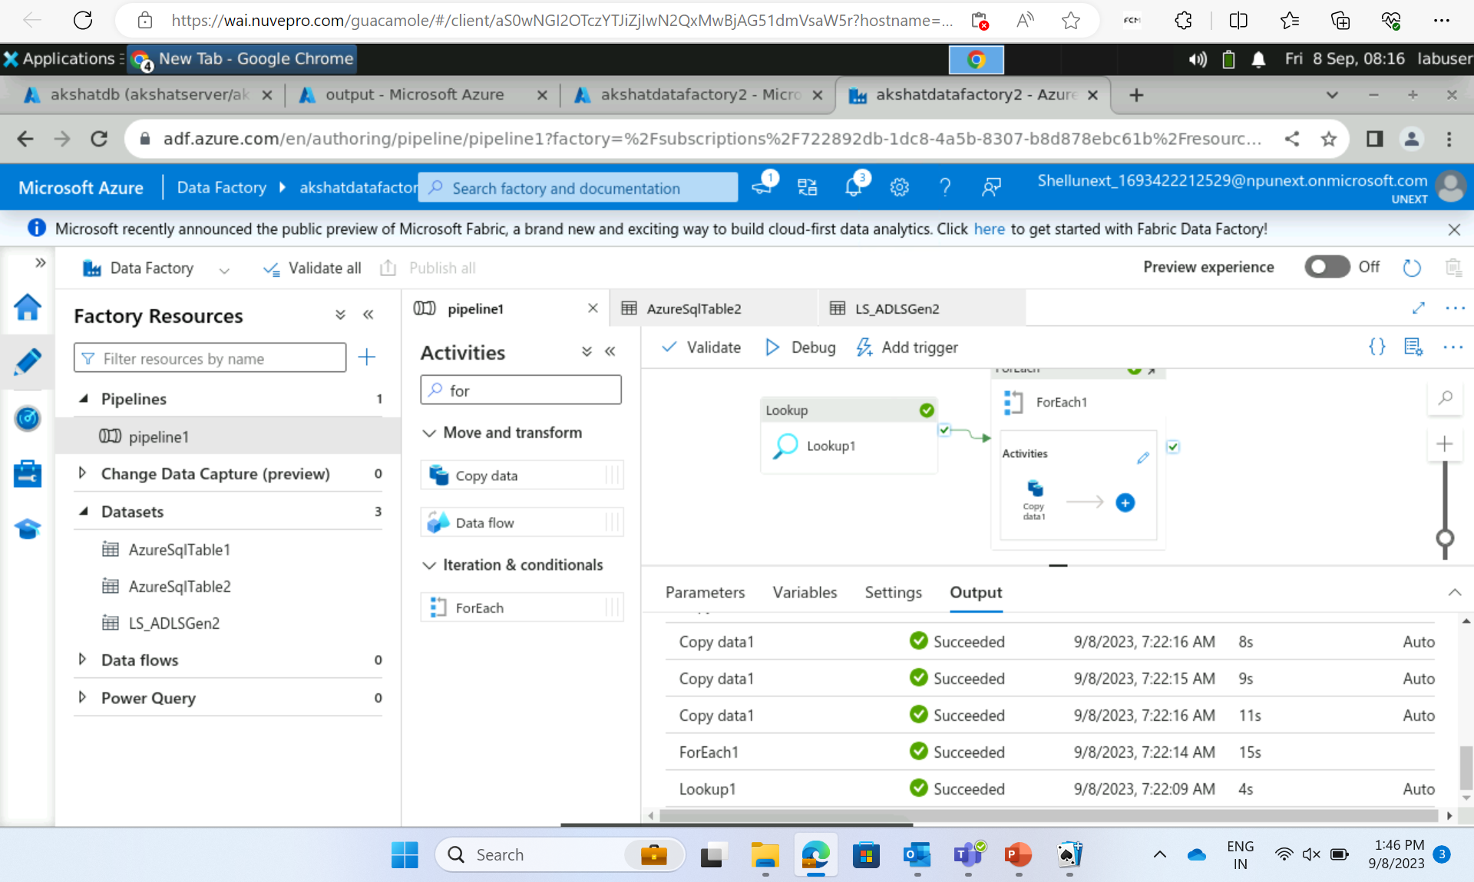

Slide 16
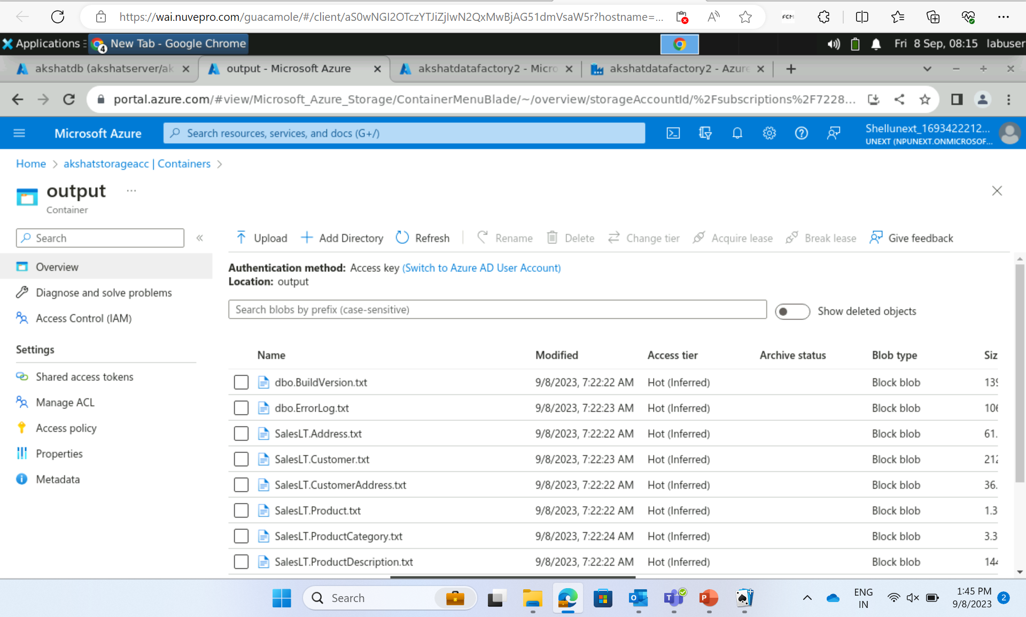

Slide 17
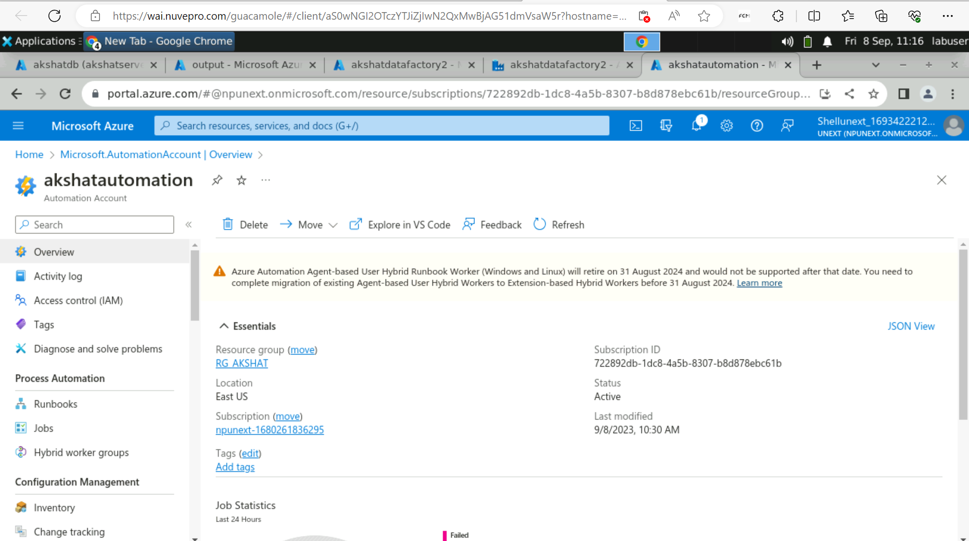

Slide 18
Thank you
Akshat Gupta
Akshat.gupta2@shell.com

